Slide 1

British Airways
Customer Feedback Analysis

Slide 2
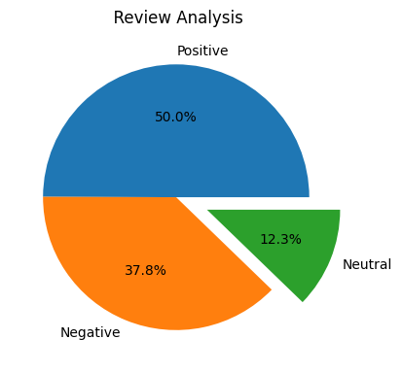
Review analysis
Sample size: 2000
Net-Promotion Score (NPS): 13.2%
Insights:
With the NPS as 13.2, the scope of increasing the promoter’s/ positive review’s share is evident.
Need for reducing Negative reviews.
Solution:
Formulate a plan to turn the Passives/ Neutrals (12.3%) into Promotors.
In-depth analysis to find the root cause for the negative reviews.
Final Thoughts:
The fastest method to increase the Promotors would be to turn Passives into Promotors as its cost-effective and time efficient than reducing the Negative review share.

Slide 3
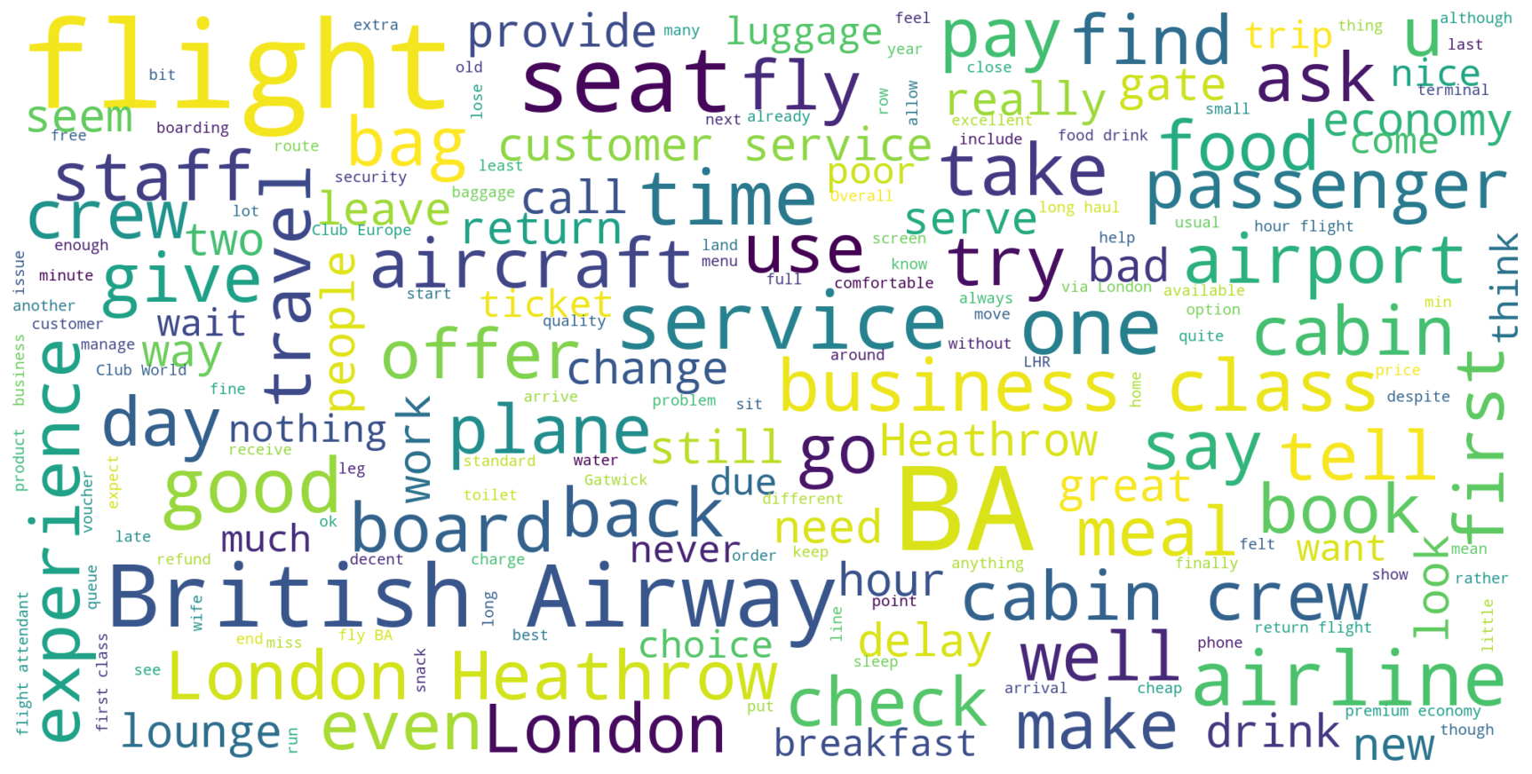
Word Cloud analysis
Majority of the comments are about fight time, airports, service and crew.
Business and economy class are mentioned equally.
Airport services such as lounge and flight experience are predominantly used. This indicates that our efforts are to be directed towards these aspects to generate better scores.

